Slide 1
Jasmine’s Journey
A Success Story

Slide 2
Age Two
When Jasmine just turned two years old, we took her for her regular visit with her pediatrician.
The doctor was concerned that Jasmine was only saying about ten words and not putting any words together or making sentences at that point.
She also noticed a lack of eye contact. Jasmine had always made eye contact with us so this is something we hadn’t noticed before.

Slide 3
Early Intervention
We contacted Gloucester County Special Education Services and were put in touch with Chris Jones, who was wonderful. She set us up for evaluations and helped us get started with early intervention.
Jasmine was a handful during the evaluations. But they showed that she needed special attention, and we were willing to do whatever was necessary for her.

Slide 4
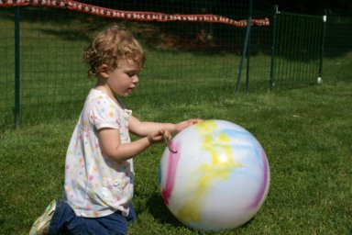
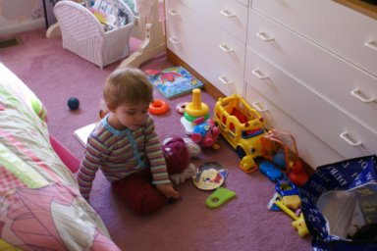
Early Intervention
Once the at-home sessions began, we saw immediate progress. One teacher in particular, Lynn Gallagher, was a miracle worker. She saw so much potential in Jasmine and her positive outlook gave us so much encouragement.

Slide 5
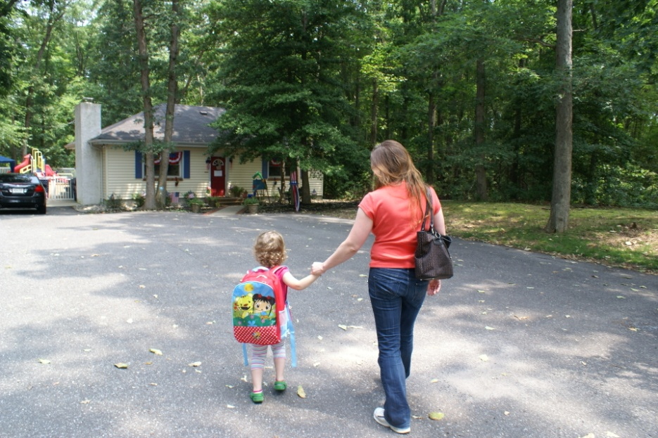
Country Acres
When Jasmine turned three, it was time to place her in an inclusion program pre-school. Dorothy Harris from the school district gave us a short list of possible choices, including Country Acres, which she felt was a perfect fit…and it was!

Slide 6
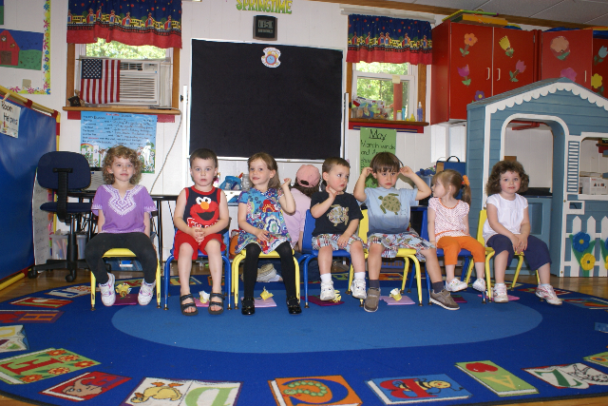
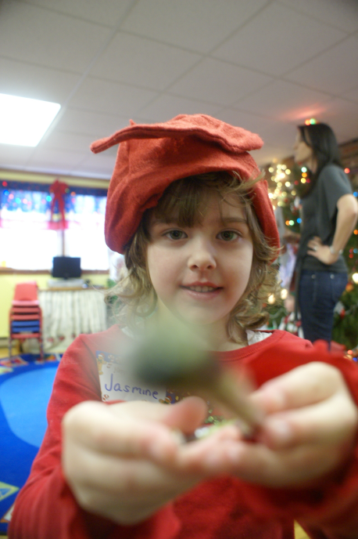
Country Acres
Jasmine thrived at Country Acres. Her speech and social skills continuously improved. The individualized attention (and genuine caring) she received were incredible. We felt like part of a family.

Slide 7
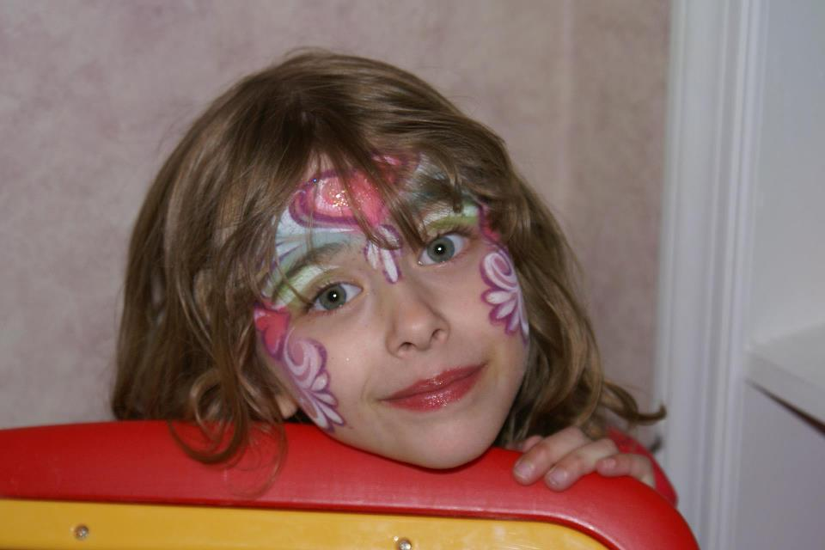
Cherrywood Academy
It was sad when Jasmine’s time at Country Acres was over, but we were happy to move her on to half-day kindergarten at Cherrywood Academy.
She also attended half-day kindergarten in the school district, so she was getting a full day of learning and peer interaction.

Slide 8
Cherrywood Academy
By the time Jasmine completed kindergarten, she was no longer displaying the behaviors associated with an austistic spectrum disorder.
Her cognitive abilities, speech, and social skills were right in line with her normally developed peers.
We still continued with summer programs at Cherrywood to prevent regression and continue the positive reinforcement.

Slide 9
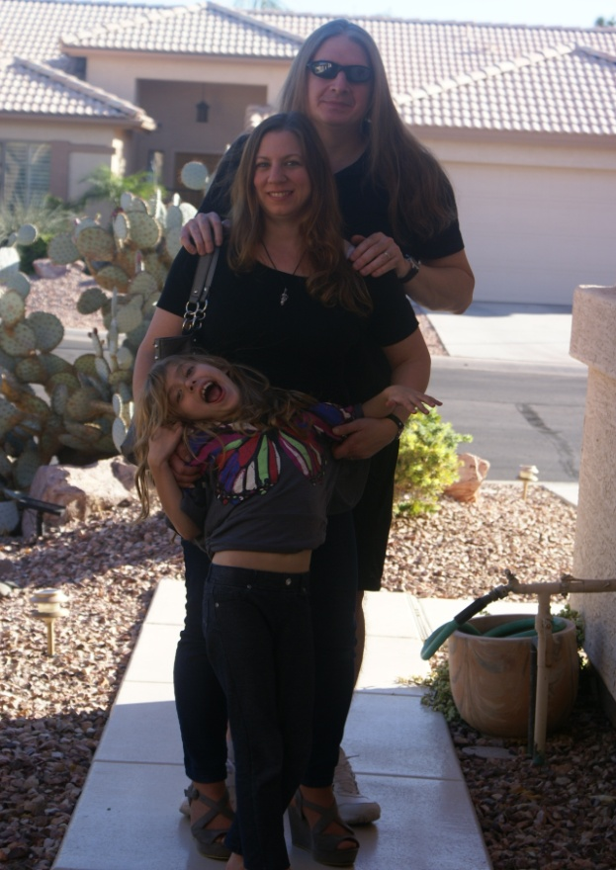
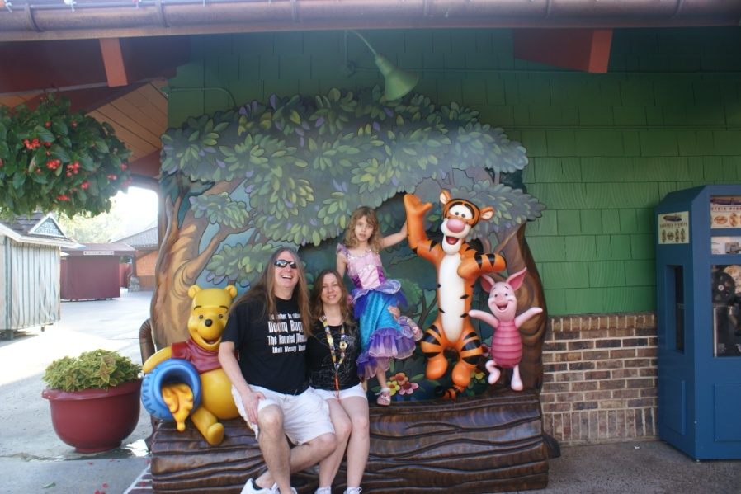
Declassification
After years of I.E.P.s and social workers and special education teachers, we were very proud and relieved when Jasmine was cleared by
a neurologist and declassified by the school district.

Slide 10
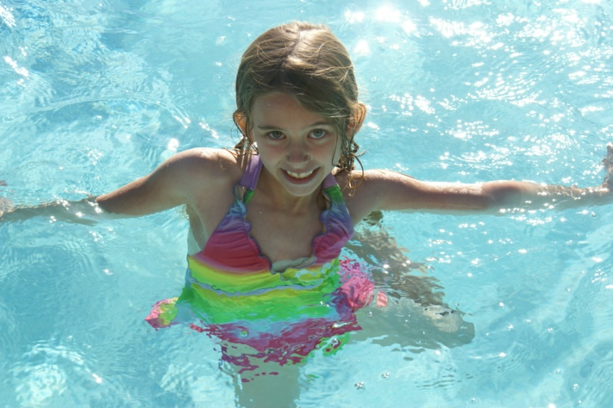
Ongoing Success
The learning and help that Jasmine got from early intervention, especially from her time with Partners in Learning, was life-changing.
She is now able to pursue her dreams and do whatever her heart desires!

